Slide 1
14- Queues

Slide 2
context
First In – First Out (FIFO) 3
Use a list to implement a Queue 4
deque object 5
What is a module? 6
Ex.1 7

Slide 3

First In – First Out (FIFO)

Slide 4
Use a list to implement a Queue
Use a list to implement a Queue in python

Slide 5
deque object
if you're dealing with a large list or a large Queue, you might see some adverse effect on the performance because Every time we remove an item from the beginning of this list, all the other items need to be shifted to the left.
In situations like that, it's more efficient to use a deque object
we need to import deque from the collections module.

Slide 6
What is a module?
I’m going to talk about modules later in the course
For now let’s imagine a module is a bucket with a bunch of reusable code

Slide 7
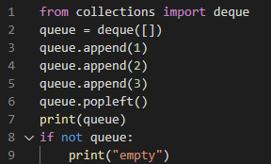
Ex.1
from collections, that's the name of our module,
import deque, which is a class again.
I'm going to talk about classes later in the course

